Slide 1


AI & Discipline: Scaling Vibe Coding
How Structured Processes Amplify AI Productivity
Presented by Eric Zimmerman

Slide 2
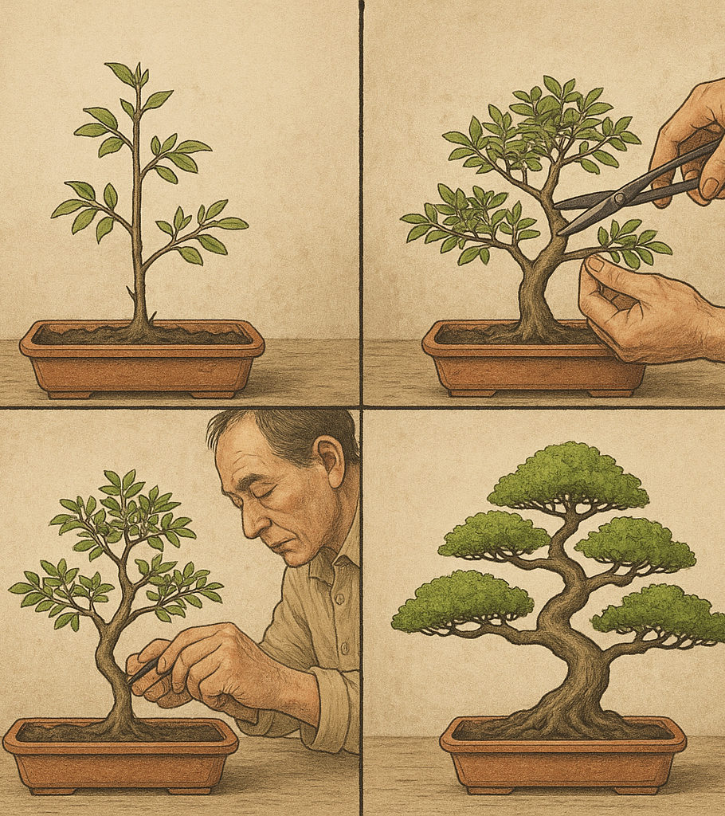
AI does not eliminate the need for discipline - it rewards it.
The more structured your process, the more value AI provides."

Slide 3

Prompt Engineering
The deliberate design and refinement of AI prompts to produce accurate, useful, and context-aligned outputs. Vibe Coding
An iterative, creative development process where humans and AI co-create—balancing structure, intuition, and experimentation to shape software or content with a consistent “feel” or intent.

Slide 4
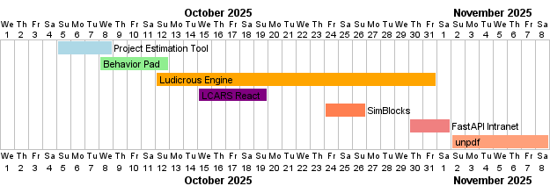
Vibe Coding Exploration
Collection of (mostly open-source) projects (on personal time) investigating planning, process and artifacts while using AI CLI tools (Claude, Copilot, Gemini, Codex)

Slide 5
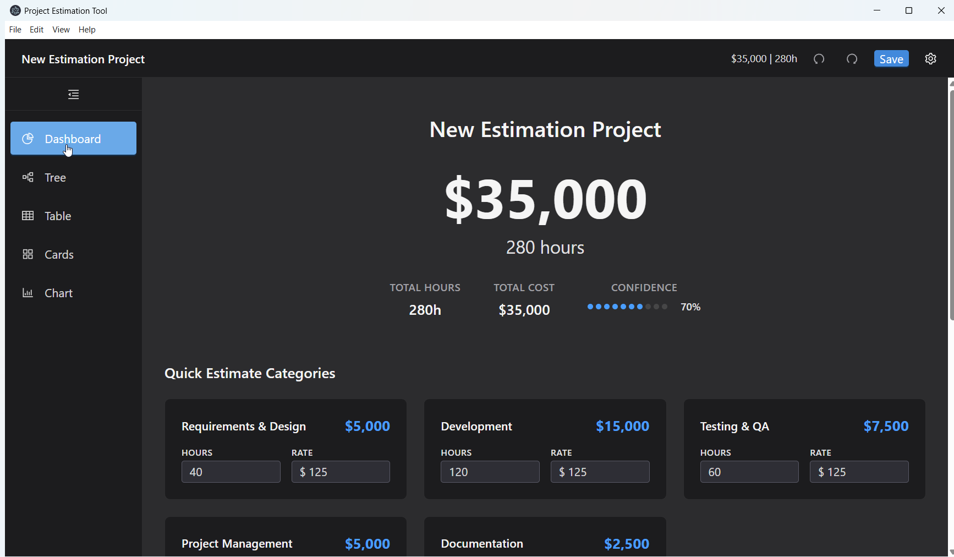
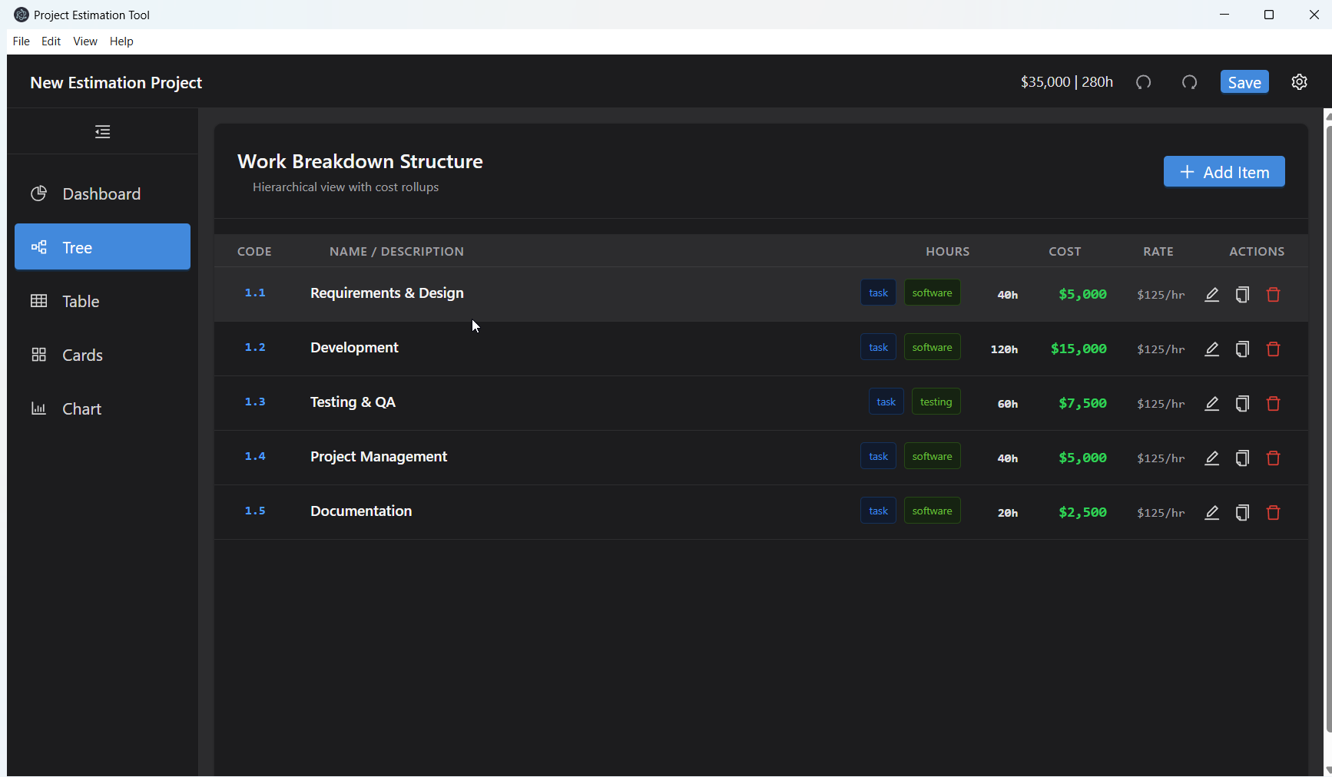
Project Estimation Test
Overview
Electron desktop app for project estimates with custom .est file format Technology Stack
Electron
React
TypeScript
Vite
Ant Design
Recharts
October 5-8, 2025

Slide 6
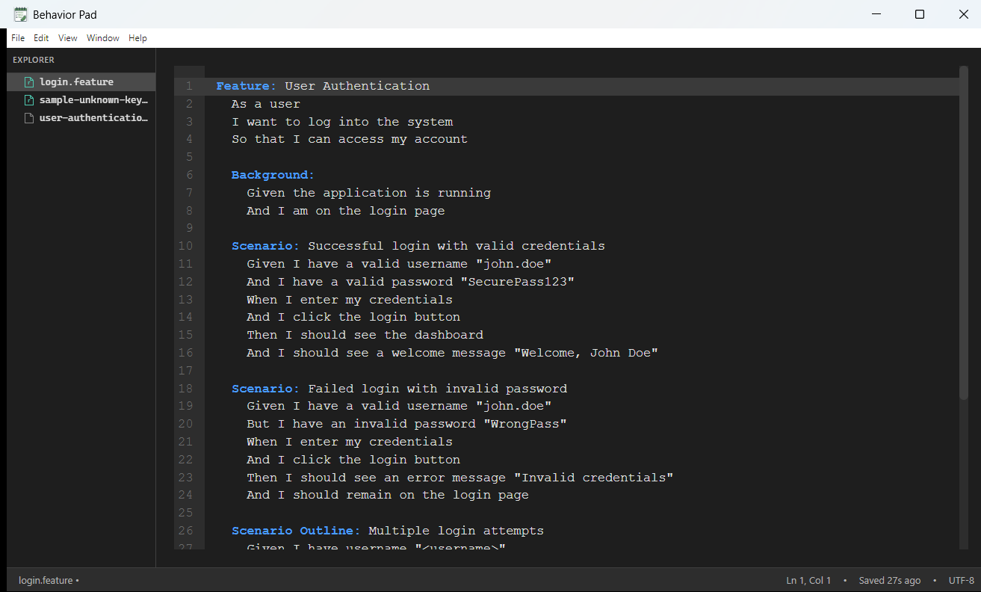
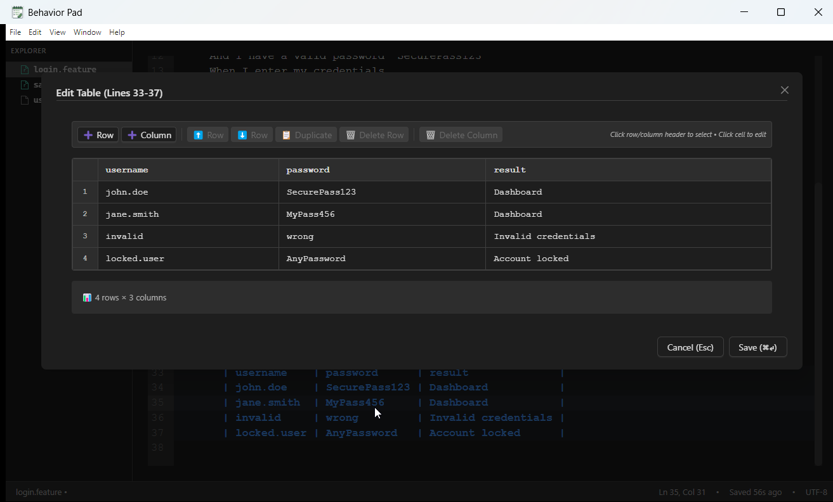
Behavior Pad – Editor Example
Overview
User-friendly Gherkin editor with syntax highlighting & auto-formatting
Features
CodeMirror 6
table editor
Markdown export
CLI tool Technology Stack
Electron
React
TypeScript
Ant Design
October 8-12

Slide 7
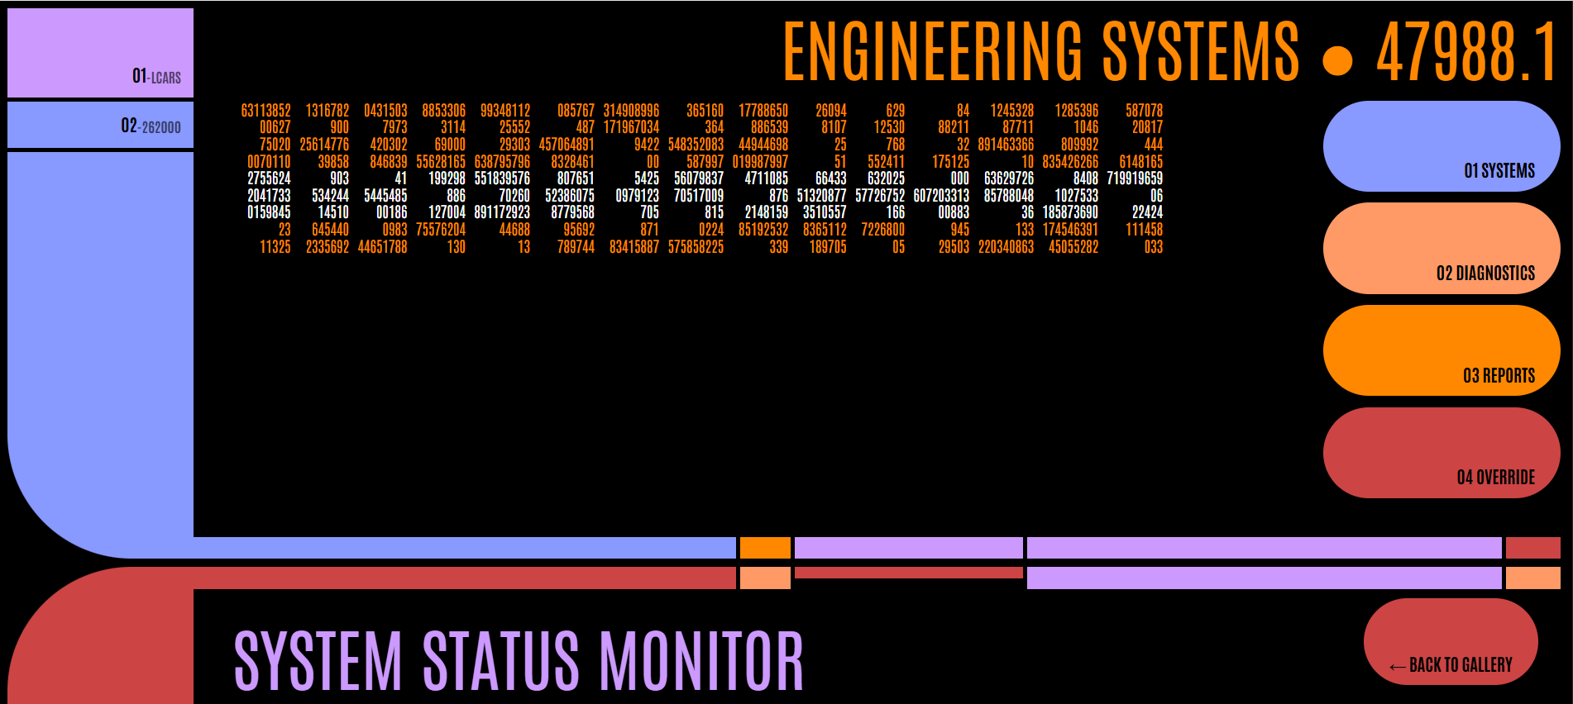
LCARS - React Test
Overview
React component library recreating authentic Star Trek LCARS interfaces. Technology Stack
React 19.1.1 with TypeScript
Vite 7.1.7 build system
CSS for scoped styling
October 15-19
Regardless of pictures, prompts, context and plans, I couldn’t get AI to design something from scratch that resembled LCARS. It wasn’t until I provided another open-source code as reference.

Slide 8
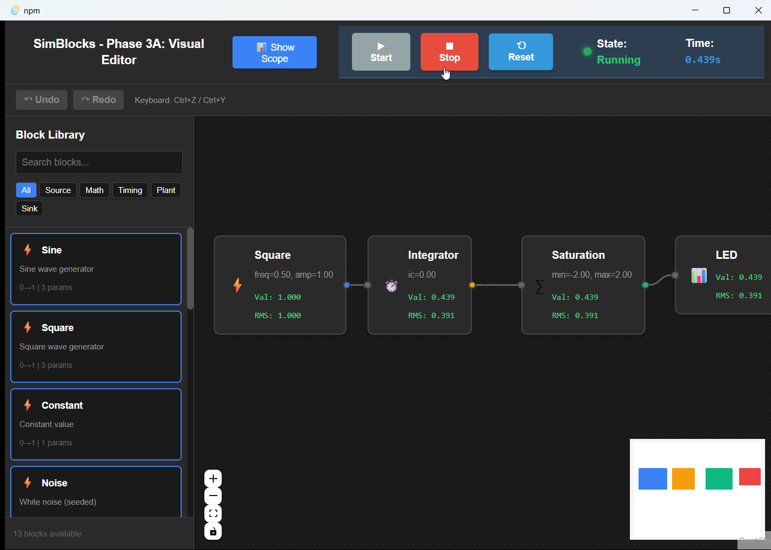
SimBlocks - ReactFlow Test
Overview
SimBlocks is a real-time block diagram simulator with a professional visual editor, designed for control systems engineering, signal processing, and educational applications.
Features
Visual block drag & draop diagram editor
13 simulation blocks
Multi-trace oscilloscope with live data
Parameter editor with live updates
Project save/load with JSON format
CSV data export for analysis
Undo/Redo with 50-level history Technology Stack
Backend: Rust, Tauri, petgraph
Frontend: React, TypeScript, Vite, React Flow
Testing: Playwright (E2E), Rust unit tests
Build System: Cargo (Rust), npm (TypeScript)
Deployment: Native Windows/macOS/Linux
October 24-26

Slide 9
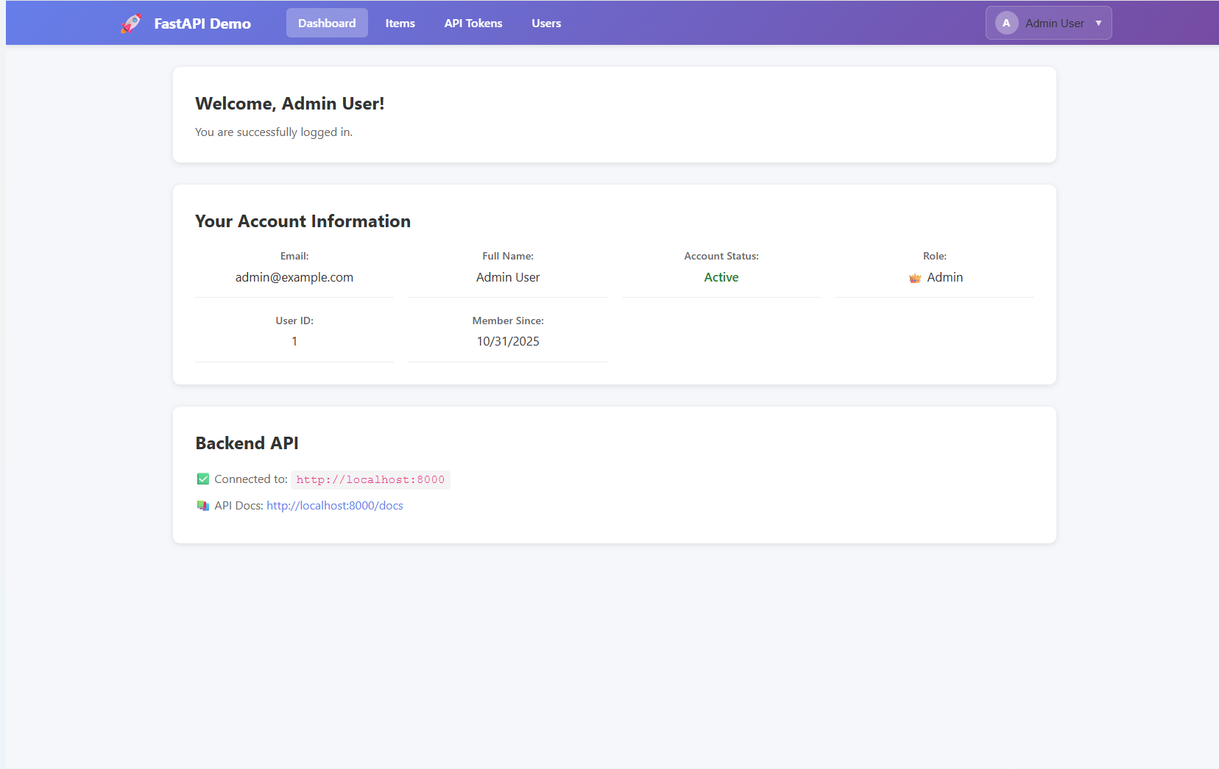
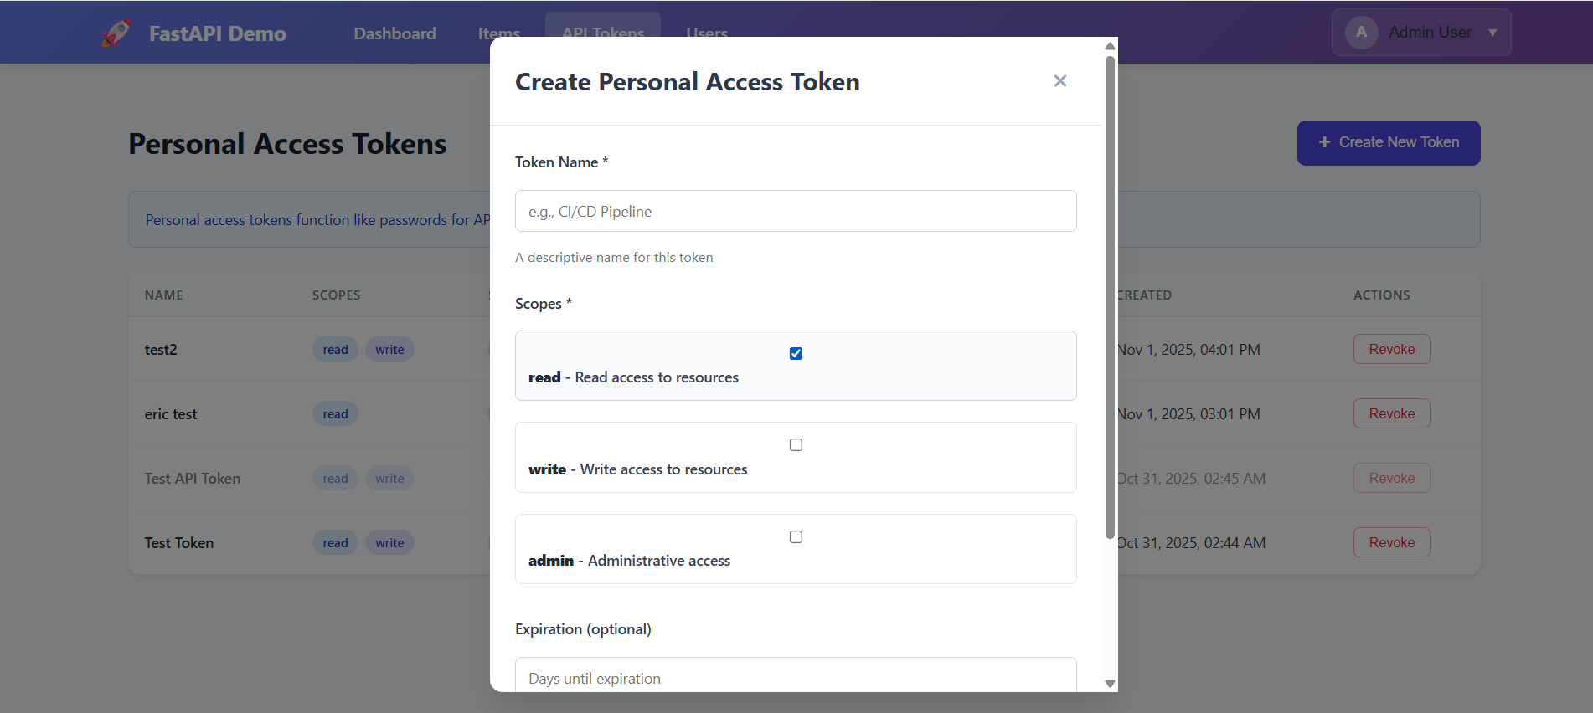
FastAPI Intranet App Template
Overview
The FastAPI Intranet Application is a full-stack intranet web application template designed with enterprise features.
Features
Robust Authentication (JWT, LDAP)
User Management
Personal Access Tokens (PATs)
Role-Based Access Control (RBAC)
Modern, responsive UI/UX Technology Stack
Backend: FastAPI (Python), SQLModel
Frontend: React, TypeScript, Vite
Deployment: Docker containers
October 30 - November 1

Slide 10

8 Principles for AI-Assisted Discipline

Slide 11
Human sets strategy → AI executes → Human verifies.
1. Treat AI as a Skilled Assistant, Not a Replacement
AI is not magic; it is a capable junior contributor. It works best when given direction, constraints, patterns, and review.

Slide 12
This converts AI from being a reactive tool into a process amplifier.
2. Start With a Clear Plan Before Using AI
Do not begin by asking AI to “do the task.”
First, ask it to help create:
A structured plan
Deliverables
Success criteria
Dependencies and phase breakdowns

Slide 13
Verification is the control system that prevents compounding errors.
3. Work Iteratively With Continuous Verification
Never assume AI output is correct.
Produce small increments
Test or verify each increment
Revise before proceeding
In any discipline, this can mean:
Checking citations
Running experiments
Peer review
Cross-reference against known constraints

Slide 14
Then ask AI to extend the pattern. (Pattern first → Consistency later)
4. Establish Patterns Early and Reuse Them
AI is strongest when following a consistent structure.
Define reusable patterns first:
Writing styles
Data report formats
Design templates
Analysis methods
Presentation frameworks

Slide 15
This builds living documentation that evolves with work rather than trailing it.
5. Generate Documentation and Explanation Continuously
Don’t “document later.”
Have AI:
Summarize reasoning
Produce guides
Capture decisions
Explain workflows

Slide 16
6. Use AI to Create Verification and Traceability Artifacts
AI can help generate:
Test checklists
Evaluation criteria
Audit trails
Rationale documentation
Traceability between goals, decisions, and results
This supports:
Compliance
Long-term maintenance
Onboarding others
Institutional knowledge retention

Slide 17
7. Reverse-Engineer Work Into Formal Descriptions
When a working system (or idea) exists, ask AI to extract:
Behavior descriptions
Requirements
Rationale
Best practices
Training material
This enables:
Retrospective clarity
Transfer of knowledge
Reuse in future projects

Slide 18
The difference is not the AI model — it’s the method you apply to it.
8. Discipline Determines Output Quality
AI amplifies your process.
A sloppy workflow → sloppy results faster.
A rigorous workflow → rigorous results faster.

Slide 19
The Meta-Principle
AI accelerates whatever exists.
If you bring:
Human Input | AI Output Result
Chaos | Faster chaos
Clear structure | Faster structured productivity
Good judgment and verification | Higher-quality results
So, the focus should be on process quality, not AI intelligence.

Slide 20

Thank you
Presented by Eric Zimmerman
https://echozulu.hashnode.dev/ai-development-gallery

